Slide 1
Tracing the Christ:
Visualizing Messianic Prophecies through the Biblical Canon
Sydni Cobb
Department of Computing Sciences and Mathematics, Franklin University
DATA 605: Data Visualization and Reporting
Dr. James O. Webb, Jr.
May 10, 2025

Slide 2
Overview
Objective: Visualize the connections of Messianic prophecies in the Old and New Testaments of the Bible
Motivation: Inspired by the Great Commission found in Matthew 28:19 (YouVersion. (n.d.))
Goal: Evangelize through data visualization

Slide 3
Cultural Context
Christianity is deeply embedded in Western culture—education, healthcare, art, politics (Wikipedia contributors, n.d.).
Major Christian holidays—Easter and Christmas—are celebrated by many non-Christians (Pew Research Center, 2013).
Gregorian calendar itself is based on the birth of Jesus (Wikipedia contributors, n.d.).
Recent trends show Christian decline in the U.S. may be stabilizing (Pew Research Center, 2025).

Slide 4
“Where are Old Testament prophecies about Christ fulfilled in the New Testament of the biblical canon?”
Exploring this question will:
Aid Christians in answering for our faith
Present a nuanced perspective of God to non-Christians using data visualization

Slide 5
Datasets

Slide 6
Datasets
Key Challenge
  Built original datasets to best fit my scope
  Goal: focus explicitly on prophecies of Christ’s arrival, birth, life, death and resurrection
Limitations of Existing Datasets
  Did not align theologically or thematically with scope
  Wanted to avoid cherry-picking the data

Slide 7
Datasets (cont.)
Solution
  Compiled a list of scholarly agreed-upon Messianic prophecies
  Minimum two scriptures per prophecy
    Old Testament (prophecy)
    New Testament (fulfillment)
Data Collection and Development
  Created Excel workbooks with detailed headers
  Used ChatGPT only to find data and return verifiable sources
  Did not use AI for analysis or visualization ideas

Slide 8
Datasets (cont.)
Messianic_Prophecy_Scriptures Workbook
  Compilation of scriptures
  Fields:
    Prophecy #
    Reference #
    Reference (Scripture)
    Scripture Text (ESV Translation)
    Book
    Testament
    Author
    Speaker
    Prophecy? (Boolean)
    Fulfillment? (Boolean)
    Original Language
    Date Written (BCE/CE)
    Midpoint Date
    Location
    Latitude
    Longitude

Slide 9
Datasets (cont.)
Prophecy Workbook
  Compilation of 63 prophecies
  Fields:
    Prophecy #
    Prophecy Description
Sources
  Data collected from verifiable Bible dictionaries, commentaries, encyclopedias, and publishers
  All sources cited in reference list

Slide 10
Data Story

Slide 11
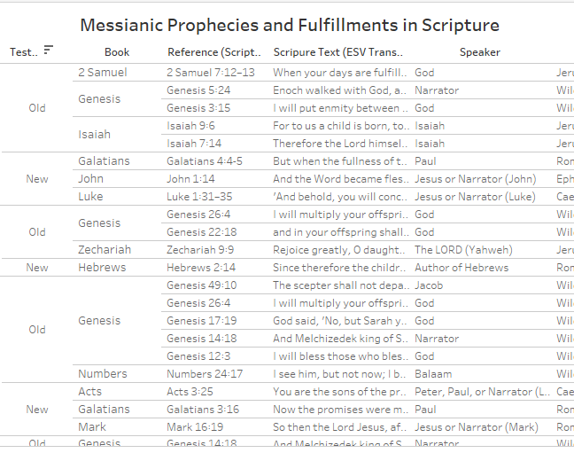
Scriptures Table
Text Table listing every scripture in datasets
Centralizes all prophecy and fulfillment scriptures
Allows comparison of authorship across prophecies
Highlights time and date differences
Encourages reflection on divine coordination

Slide 12
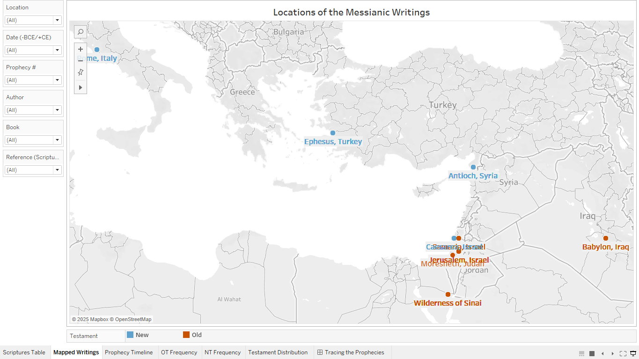
Mapped Writings
Interactive map showing where each scripture was written
Uses geospatial data
Color differentiates Old and New Testaments
Tooltips and filters allow for
comparison of scriptures

Slide 13
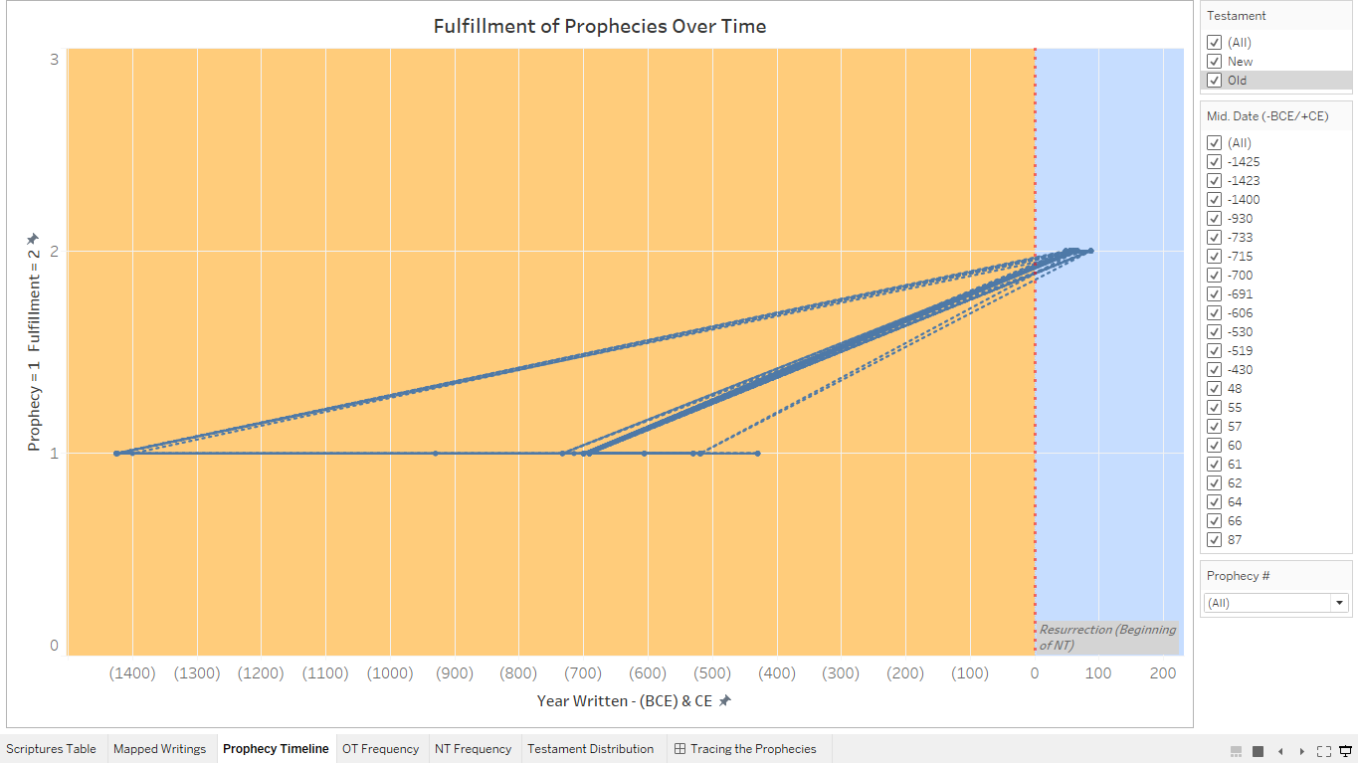
Prophecy Timeline
Scatterplot with Line Marks (line chart)
X-axis: Midpoint Date (whole number)
Y-axis: calculated field Axis Point (Old Testament = 1, New Testament = 2)
Reference line and pane coloring to
show BCE/CE split
Optional filters and tooltips for clarity
and exploration
Limitations:
  No date data type
  Visual clutter
  Design challenges

Slide 14
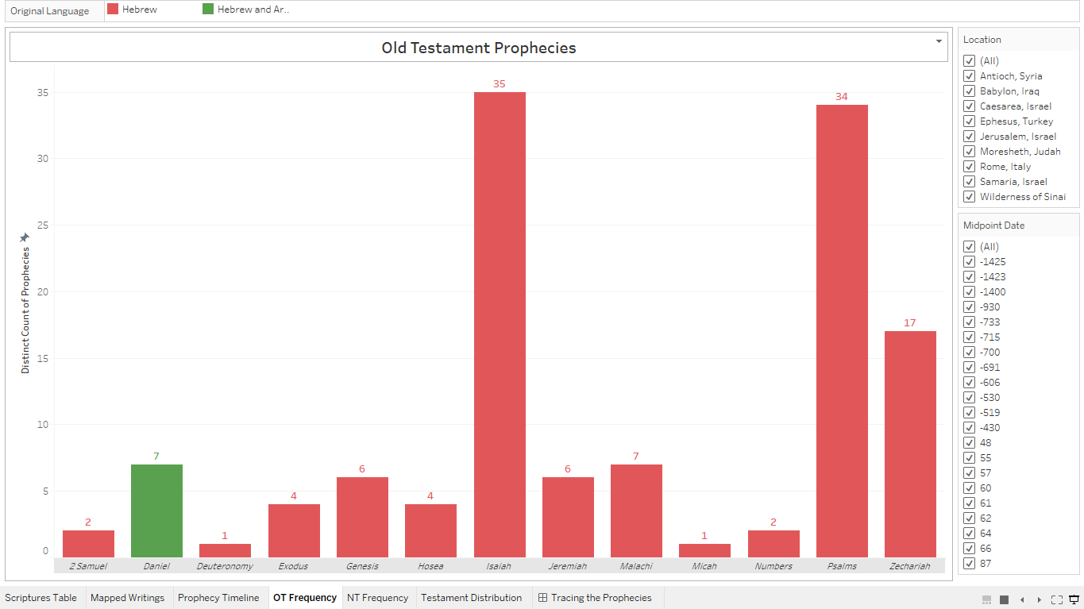
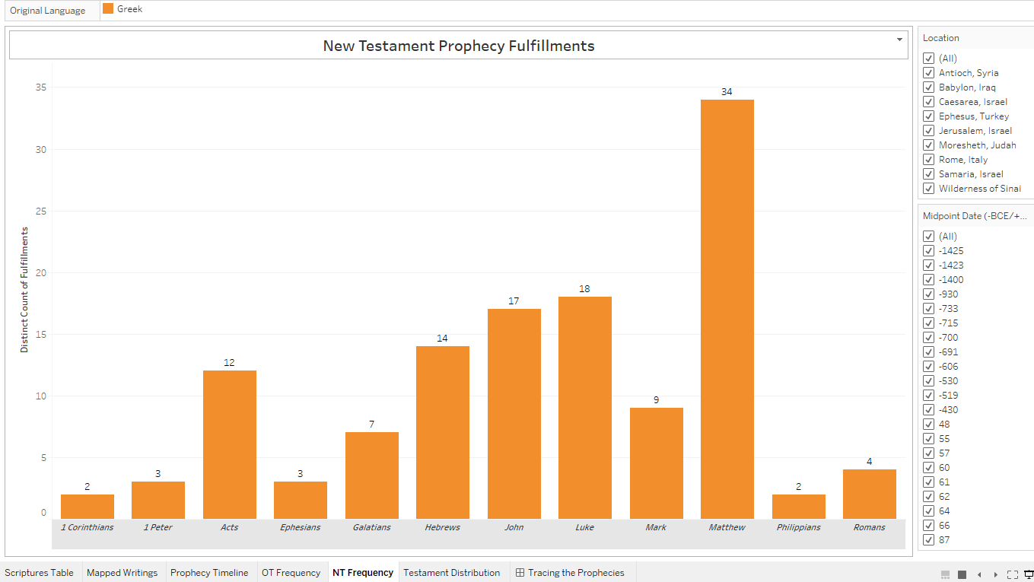
OT/NT Frequency
Two bar charts (one each for Old and New Testaments)
Columns: Book field
Rows: Distinct Count of Prophecy #
Filters applied to Testament, respectively
Labeled columns with Distinct Count of Prophecy #
Original Language on Color Mark
Tooltips and optional filters for detail and exploration

Slide 15
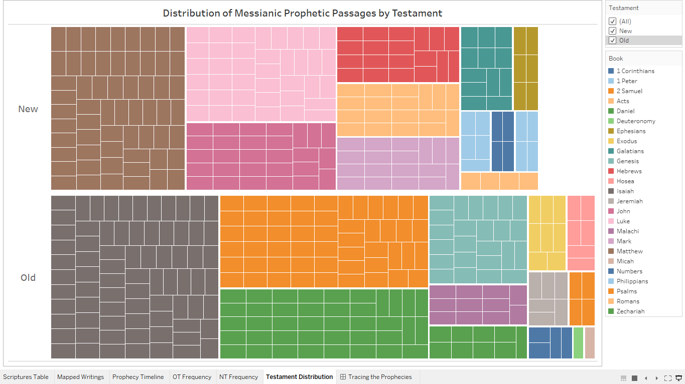
Testament Distribution
Treemaps showing distribution of scriptures in each Testament
Marks used
  Book (Color and Detail)
  Reference # (Detail)
  Count of Reference # (Size)
Tooltip details each scripture
Optional filters and color legend for interactivity
Rich in detail, not completely accurate (duplicates)

Slide 16
Dashboard
Tracing the Prophecies

Slide 17
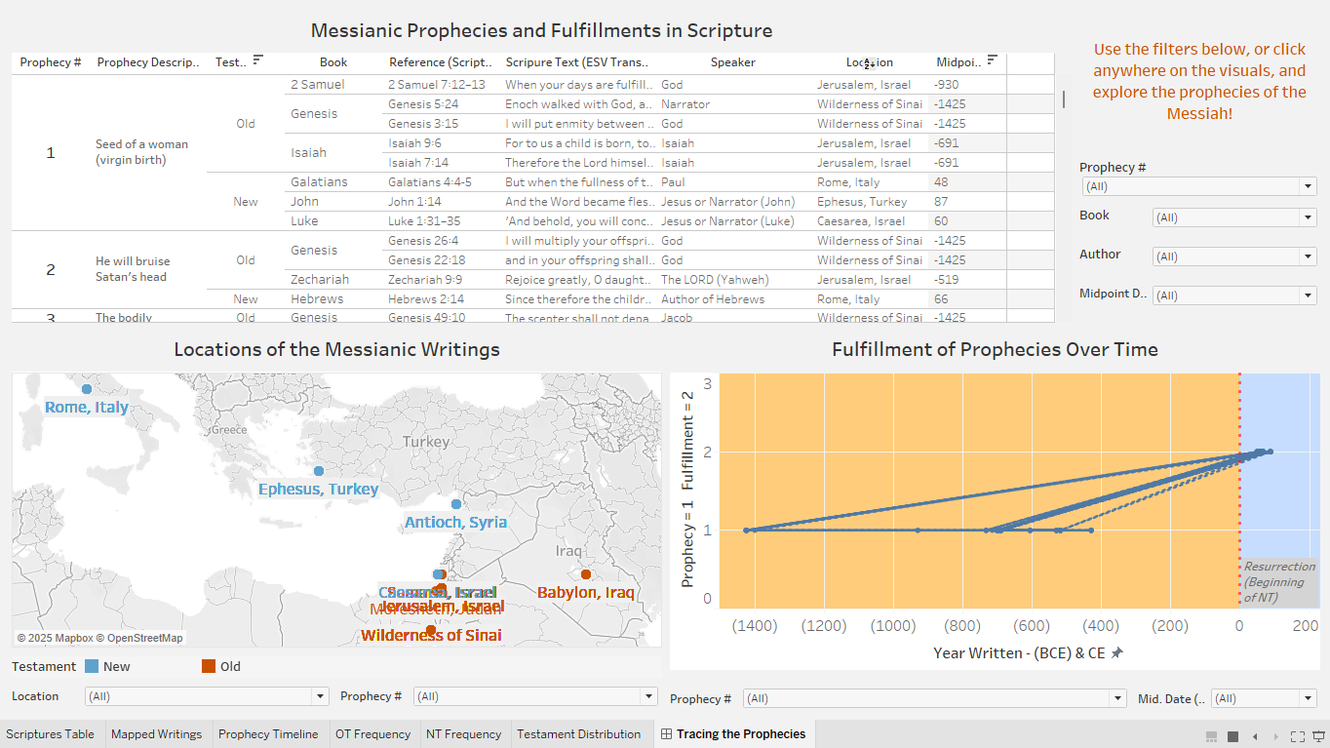
Tracing the Prophecies
Dashboard combining the map, line chart, and text table sheets
Goal: demonstrate scripture connections alongside time and location variances
All sheets are interactive
Instructions for exploring
Carefully selected filters
Limitations carried over from worksheets
Overall, insightful and informative, demonstrating the continuity of Messianic prophecies

Slide 18
Summary and Conclusions
Successfully visualized 63 Messianic prophecies and fulfillments
Revealed continuity alongside time and location variances
Self-made dataset introduced roadblocks and learning curves
Valuable tool for exploring Christianity through data analysis
Shows the complex continuity of Messianic prophecies in scripture
Encourages speculation of divine intervention by demonstrating overlap of facts and faith

Slide 19
References
Pew Research Center. (2013, December 18). Celebrating Christmas and the holidays, then and now.
https://www.pewresearch.org/religion/2013/12/18/celebrating-christmas-and-the-holidays then-and-now/
Pew Research Center. (2025, February 26). Decline of Christianity in the U.S. has slowed, may have leveled off.
https://www.pewresearch.org/religion/2025/02/26/decline-of-christianity-in-the-us has-slowed-may-have
leveled-off/
Wikipedia contributors. (n.d.). Role of Christianity in civilization. Wikipedia. Retrieved April 19, 2025, from
https://en.wikipedia.org/wiki/Role_of_Christianity_in_civilization
YouVersion. (n.d.). Matthew 28 (English Standard Version). Bible.com. Retrieved April 19, 2025, from
https://www.bible.com/bible/59/MAT.28.ESV

